Slide 1
Origins of the tower harbor shores loan
Presentation given Oct. 3, 2019 by Marshall Helmberger
Tower Economic Development Authority

Slide 2
A brief history Origins of the town home concept
The town
home concept originated with the City of Tower’s Harbor Committee comprised of Steve Altenburg, Linda Keith, and Josh Carlson. They are the ones who recommended issuance of RFQ.

Slide 3
Harbor committee accepts RFQ from orlyn Kringstad’s group in early 2016
• Original plan called for the city to purchase development services from Kringstad’s group along with sales/marketing services by local realtors.
• Feb-March, 2016: Harbor Committee later changes its mind and requests Kringstad’s group to become lead developer on the town home project. Kringstad’s group agrees, and a development agreement is drafted and eventually signed.
• Based on the city’s commitments, Tower Vision 2025 and Tower Harbor Shores are created as LLCs and begin search for investors. About $160,000 in private development capital is raised, which fell short of the start-up funds required.

Slide 4
January 2017: TEDA board re-engages, expanded to seven members
• New members include Stephen Peterson, Sr., Joan Broten, Marshall Helmberger, Victoria Meloche, Marit Kringstad, and council representatives Brooke Jankowski, and Brad Matich.
• TEDA charged with advancing economic development projects, particularly projects (such as harbor town homes) identified as high priorities for the city.
• In February, 2017, Kringstad informed new TEDA president Marshall Helmberger of the difficulty of obtaining start-up investment. Real estate projects are generally considered high risk which makes them unattractive to smaller investors. THS P&L identifies a $125,000 funding gap.
• Helmberger proposes a meeting with IRRRB Commissioner Mark Phillips to discuss a gap loan. Meeting takes place in February 2017 and the commissioner expresses strong support for funding the project.

Slide 5
IRRRB proposes grant/loan with TEDA as the pass-through
• TEDA begins work to develop and approve the required documentation to obtain the grant which IRRRB agrees to provide for the express purpose of addressing an identified funding gap in the project.
• KEY POINT: GRANT WAS ONLY PROVIDED TO ASSIST THE TOWN HOME PROJECT. IF THE LOAN WAS NOT APPROVED, NO FUNDS WOULD HAVE BEEN OBTAINED BY TEDA TO ADVANCE A HIGH-PRIORITY CITY PROJECT.
• TEDA’s work included development of loan guidelines (adapted from similar guidelines used by other Range cities), examination of profit and loss statement and cash flow projection from THS, along with a determination of the eligibility of the proposed uses of the money.

Slide 6
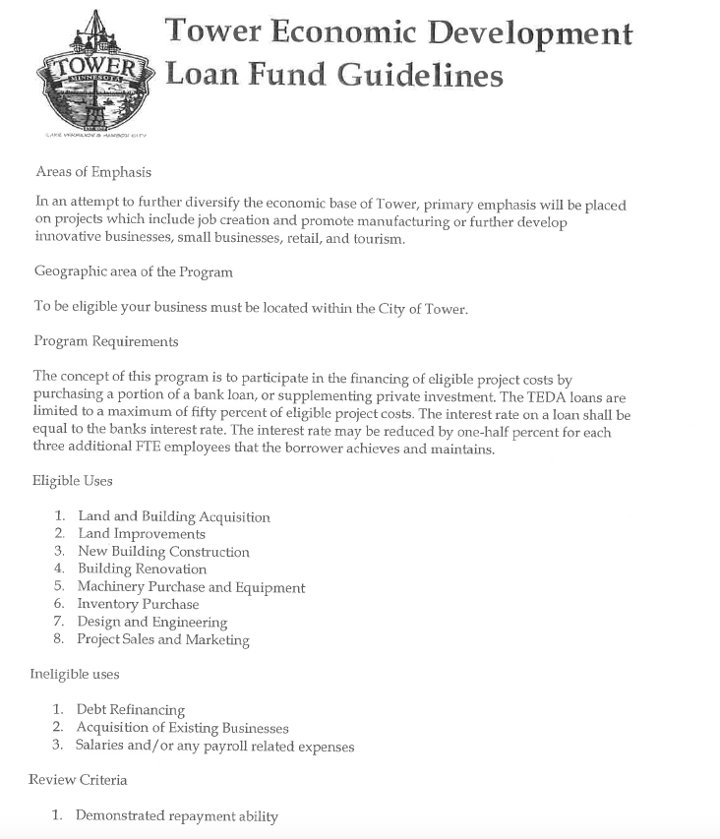
• Guidelines were generic. The only actual requirements included restrictions on eligible uses and a funding limit equal to 50-percent of eligible expenses.
• Also includes general review criteria but gives no guidance as to weighting
the various criteria. There is clearly no requirement that a project meet all, or even most, of the criteria. The guidelines provide maximum flexibility for TEDA to assess project strengths and weaknesses on a case-by-case basis.

Slide 7
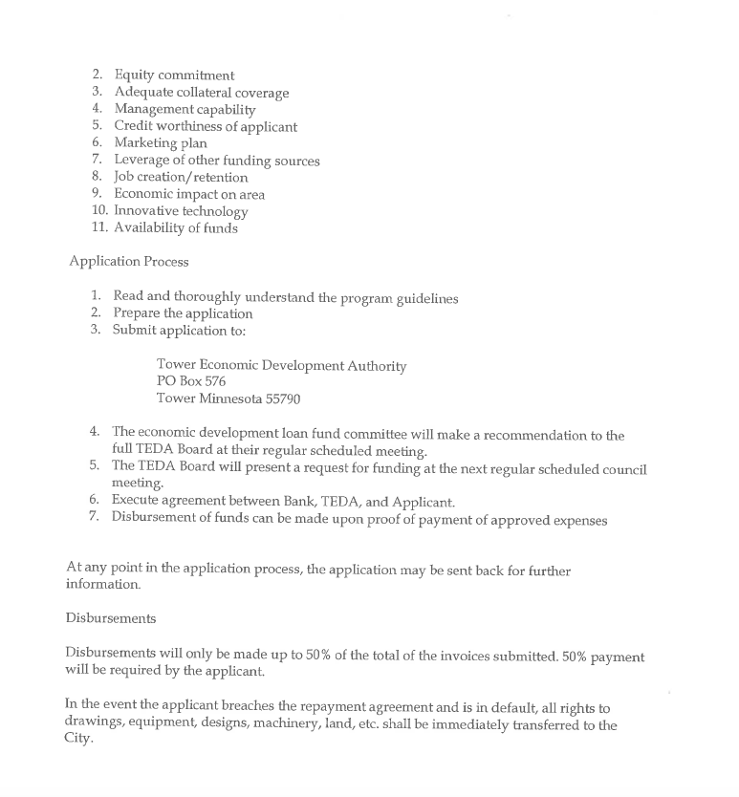
The THS project clearly met the intent of the guidelines and ranked well on most of the review criteria, including demonstrated repayment ability, equity commitment, management capability, marketing plan, leverage of other funding sources, job creation, economic impact on area, and availability of funds.
KEY POINT:
IRRRB RAISED NO CONCERNS ABOUT COMPLIANCE WITH THE GUIDELINES.

Slide 8
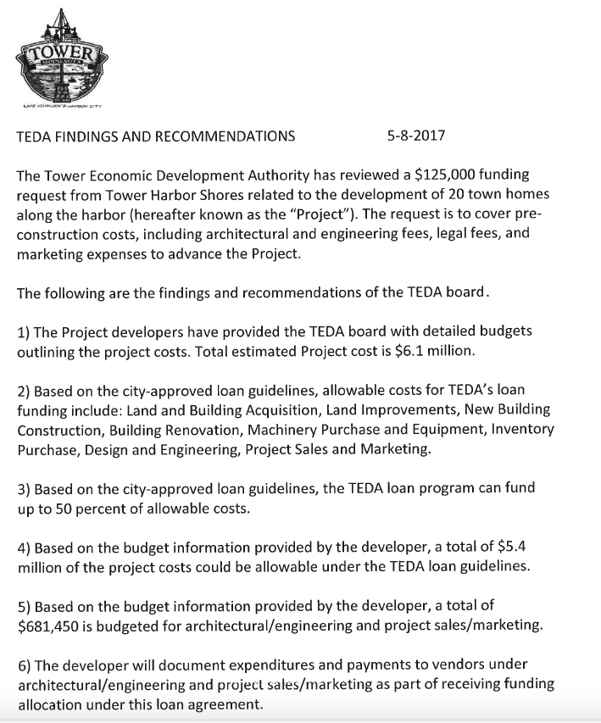
At May 8, 2017 meeting, the TEDA board examines financial data and develops findings.
Findings include:
• Project includes eligible costs under the loan guidelines totaling $5.4 million.
• Project includes eligible start-up costs, some already expended, totaling $681,450.
• The $125,000 in available loan funds would equal far less than 50-percent of eligible costs.
• Developer would be required to document eligible expenditures and payment to receive funds.

Slide 9
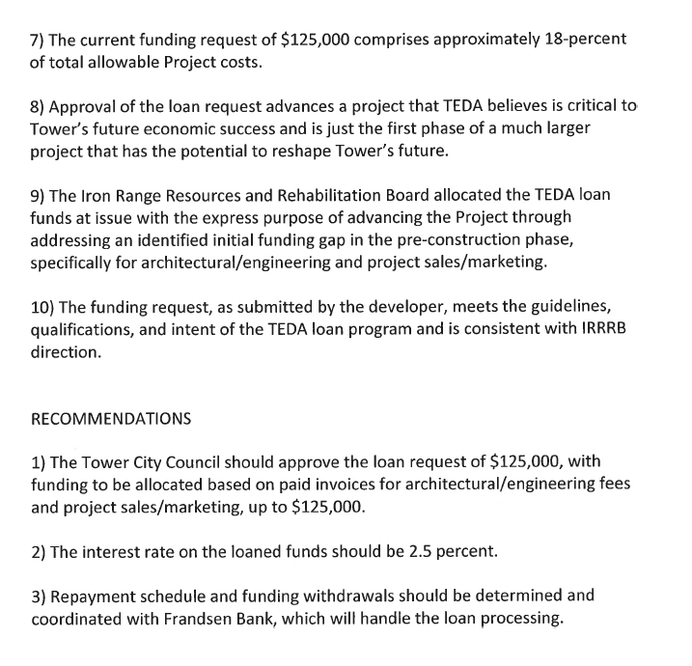
Findings issued by TEDA were factual and accurate.
Mr. Altenburg claims that the loan “met none of the requirements in the guidelines.”
THIS IS A PROVABLY FALSE AND RECKLESS STATEMENT
The loan met the only actual requirements in the guidelines, including eligible uses and the 50-percent equity requirement.

Slide 10
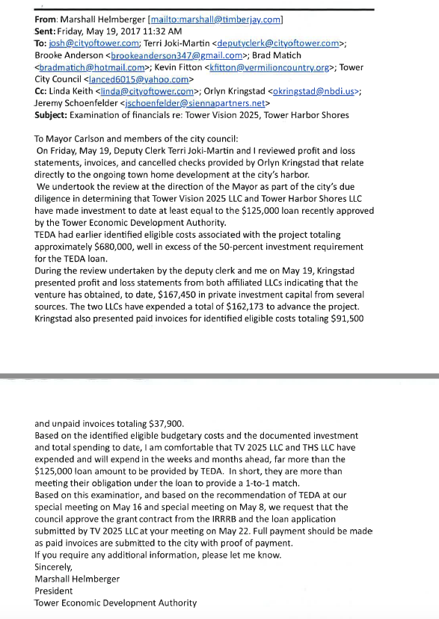
On May 19, 2017, Deputy Clerk-Treasurer Terri Joki Martin and Marshall Helmberger reviewed additional financial information and invoices to document the 50-percent equity requirement.
Findings included:
• That the two LLCs had obtained $167,450 in private investment capital to that point.
• That the two LLCs had expended $162,173 to advance the project as of that date.
• That the developer presented paid invoices for what appeared to be $91,500 in eligible costs and unpaid invoices for an additional $37,900.

Slide 11
Based on our May 19 review and the earlier findings approved by TEDA, Marshall Helmberger recommended to the city council that they accept the IRRRB funds and approve the loan, but stated that:
“Full payment should be made as paid invoices are submitted to the city with proof of payment.”
AT THIS POINT, TEDA’S INVOLVEMENT WITH THE
LOAN WAS ESSENTIALLY COMPLETE.
Processing/verification of invoices submitted for payment was the purview of the former city clerk-treasurer. Loan processing was handled by Frandsen Bank. TEDA had no other direct role in the handling of this loan. TEDA never saw, reviewed, or approved any actual payment of loan proceeds. That was the responsibility of the former clerk-treasurer.

Slide 12
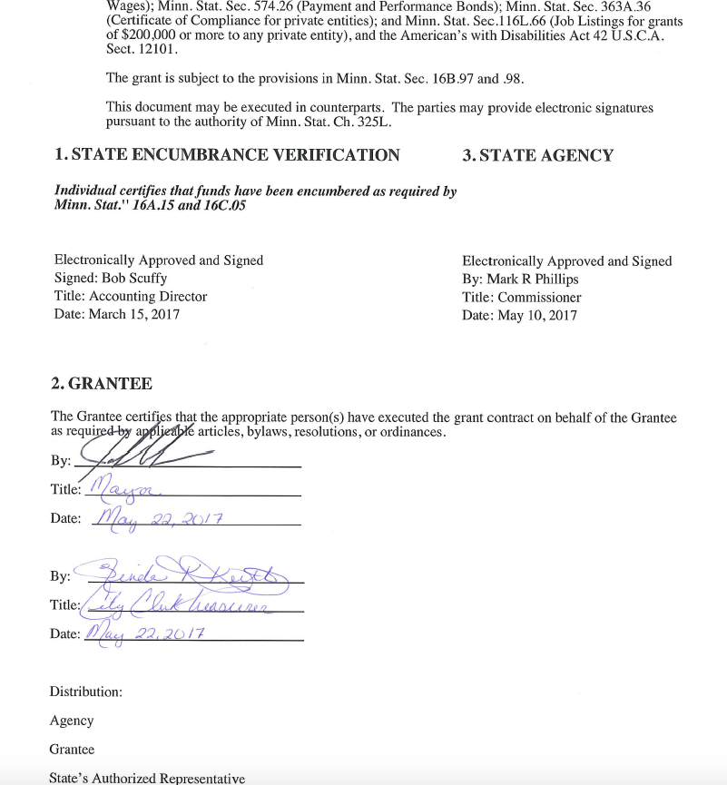
• The loan invoices submitted for payment under this loan were reviewed and approved for payment by Linda Keith as they were submitted by the developers.
• The loan contract with the IRRRB was signed by former Mayor Josh Carlson and Linda Keith. No one from TEDA was a party to the grant, nor did TEDA review the invoices submitted under the loan agreement. In fact, Linda Keith had insisted that everything be run through city hall under her authority and that TEDA NOT MANAGE THE GRANT/LOAN.

Slide 13
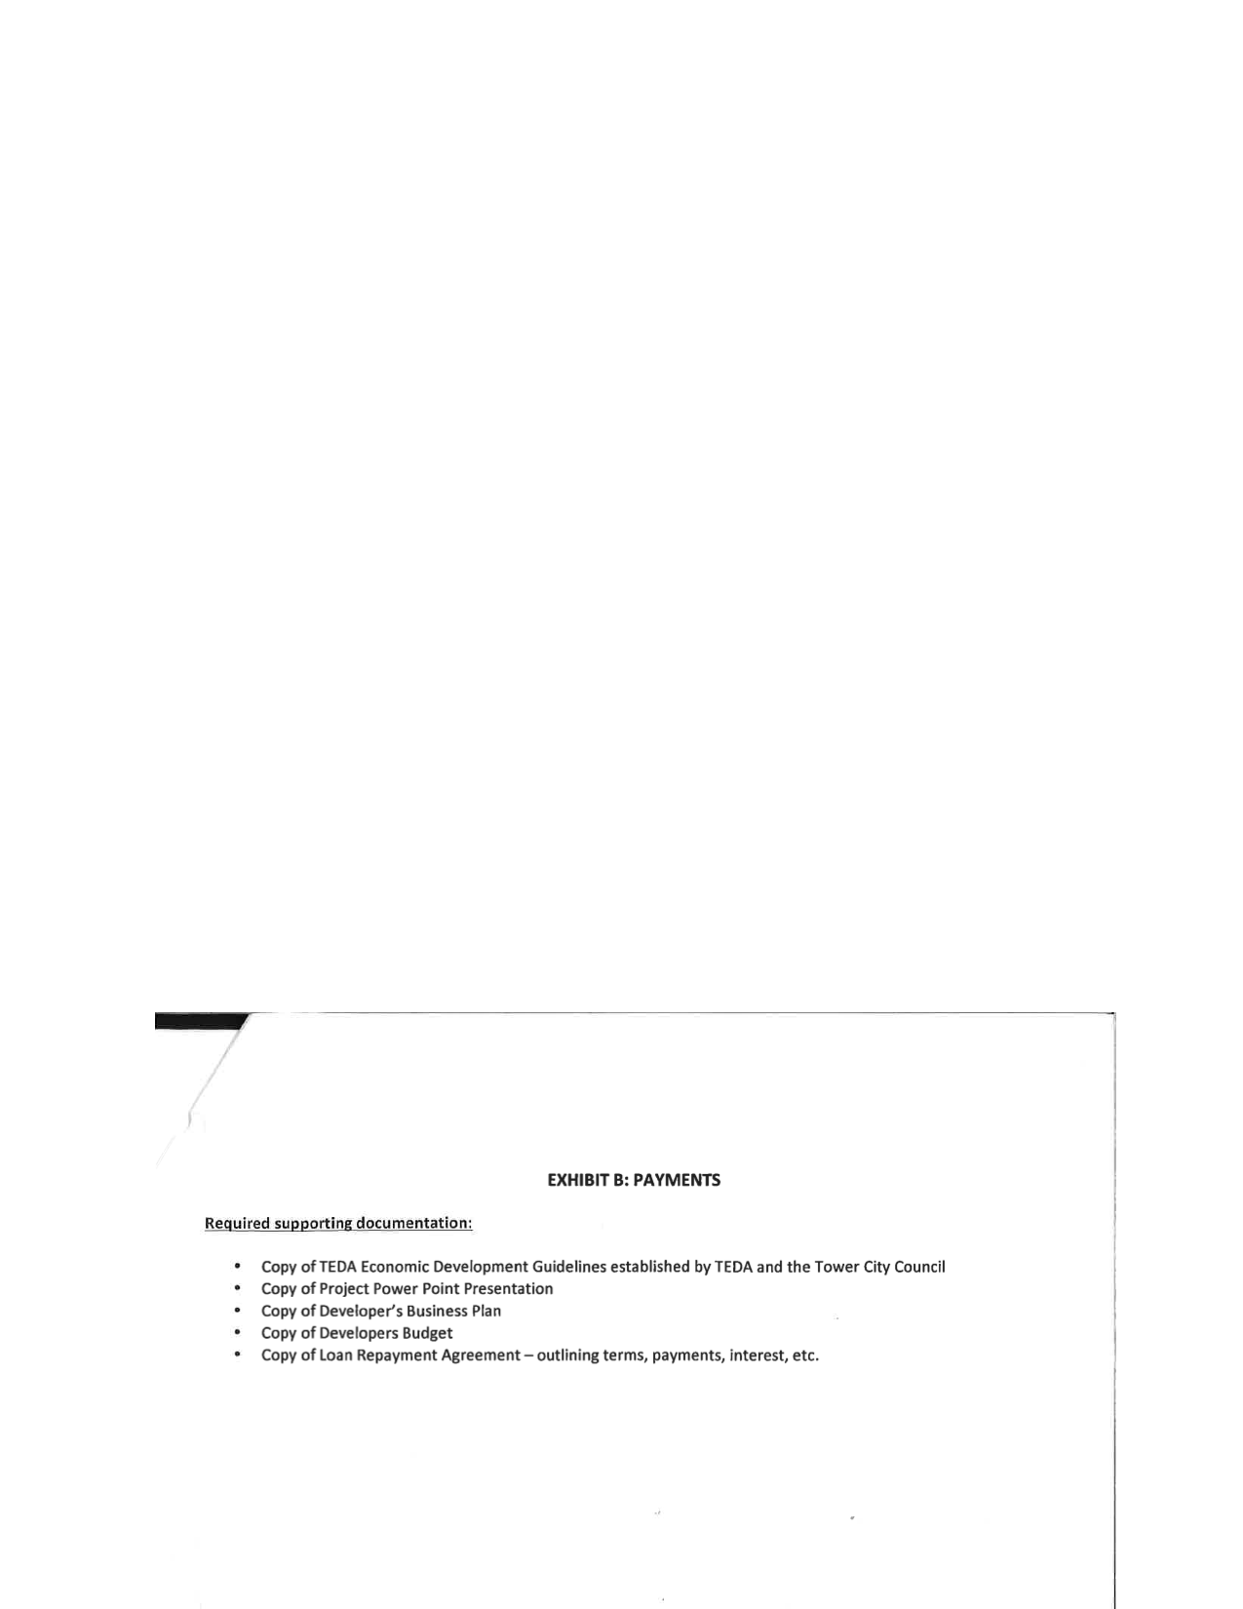
IRRRB-required supporting documentation per contract
IRRRB grant administrator Chris Ismil reviewed the loan processing and found it compliant with agency requirements and the grant contract. The IRRRB issued the full grant payment to the city in August, 2017, and the grant was closed out.
NO ISSUES WITH LOAN COMPLIANCE WERE RAISED BY THE IRRRB THAT EVER CAME TO TEDA.

Slide 14
So let’s examine mr. Altenburg’s claims
Claim:
“The city’s attorney after being informed of the entire history behind the loan then instructed Clerk/Treasurer Linda Keith to submit those concerns to the State Auditor.”
Claim:
“Under T.E.D.A. President Marshall Helmberger, a letter was sent to the City council from T.E.D.A. recommending the City approve the loan to Kringstad, stating that the application for the loan met all the loan requirements.”
Reality:
City Attorney Andy Peterson has denied in writing that he ever instructed Ms. Keith to submit her concerns to the auditor.
Reality:
It’s unclear what letter Mr. Altenburg is referring to. If he is referring to the Findings issued by the TEDA board, the board documented that the project involved more than an adequate amount of eligible uses and the 50-percent equity requirement, which were the only actual requirements in the guidelines.

Slide 15
Claim:
“…and the City approved the loan based on that false letter.”
Claim:
“The application did not meet any of the loan requirements.”
Reality:
Mr. Altenburg has presented no evidence that the Findings were inaccurate. In fact, they were thoroughly documented with records available in city files.
Reality:
This false statement has already been debunked. The project complied with all requirements for eligible uses and equity percentage (as documented by the TEDA board) and ranked highly on the vast majority of the review criteria, including demonstrated repayment ability, equity requirement, management capability, marketing plan, leveraging of other funds, job creation/retention, economic impact on area, and availability of funds.

Slide 16
Reality:
The auditor, during review of 2017 finances, noted that the city had done an inadequate job of documenting why the clerk-treasurer paid out reimbursement differently than described in the grant agreement. In fact, she paid out more than the loan amount in error, and miscalculated interest which was her mistake. The lack of documentation was Ms. Keith’s responsibility. TEDA had no requirement nor expectation to provide this documentation.
Reality:
THIS IS PROVABLY FALSE. The invoice in question makes no reference to a “buy-out,” but, in fact, referenced his decision not to become a partner in the project in the first place.
MR. THORBECK WAS NEVER A PARTNER IN EITHER TOWER VISION OR TOWER HARBOR SHORES AND MR. ALTENBURG AT NO TIME MADE ANY EFFORT TO VERIFY THIS KEY POINT.
THIS IS THE DEFINITION OF “RECKLESS DISREGARD FOR THE TRUTH.”
Claim:
“The inconsistencies with the T.E.D.A. loan were also noted by the City’s auditors who requested it be examined by the City’s attorney.”
Claim:
“A reimbursed invoice from the architect states that it is final payment for his interest in the Tower Harbors Shores LLC partnership, which it is illegal to use public funds to buy out partners.”

Slide 17
Claim:
The State currently has an open and active investigation into the misappropriation of public funds and fraud, allegedly committed by Kringstad and Helmberger.”
Claim:
“Mandatory Reporting Requirements for Local Government Officials and Employees, Minnesota Statute section 609.456, subd. 1 makes it illegal for any person listed in that statute to not report fraud.”
Reality:
Mr. Altenburg has no evidence that the auditor has an active investigation. No one Mr. Altenburg has accused of wrongdoing has been contacted by the auditor four months after filing his complaint— and the auditor has no actual evidence of wrongdoing, only evidence of Mr. Altenburg’s vivid imagination and extreme bias.
Reality:
Mr. Altenburg has misstated this law, which makes no reference to “fraud” and could not apply to anyone on TEDA nor to Mr. Kringstad during the period in question. Mr. Altenburg has made it clear that his real objective is protecting himself from accountability by falsely claiming he’s a whistleblower. In fact, he’s engaging in defamation against TEDA, myself, and Mr. Kringstad. His actions are unethical.

Slide 18
SUMMARY OF ISSUEs SURROUNDING TEDA/THS LOAN
• The harbor town home concept was developed and advanced by the Tower Harbor Committee, comprised of Steve Altenburg, Linda Keith, and Josh Carlson
• TEDA became involved in 2017 in an effort to obtain IRRRB funds to advance the project which had struggled to obtain sufficient start-up investment capital.
Obtaining IRRRB funds was contingent on loan approval.
• Loan clearly met the actual requirements of the guidelines and ranked strongly on most review criteria. Mr. Altenburg’s claims to the contrary are false and lack any documentary support. IRRRB raised no issues with legal compliance per guidelines.
• TEDA fulfilled its due diligence by reviewing financials to confirm that developers met the requirements of the loan. This was fully documented.
• Claim of improper buy-out is false and without foundation.
• City has benefitted financially from the grant, since some loan proceeds and interest have been repaid and loan will be repaid in full if the project moves forward.

Slide 19
OPTIONS TO ADDRESS MR. ALTENBURG’S DEFAMATION
• Recommend that the city council issue a letter of reprimand to Mr. Altenburg for his defamatory statements against TEDA and require that he issue a public apology at an upcoming city council meeting and submit a retraction of his false claims that appeared in the Tower News on Sept. 13.
• That TEDA submit a retraction demand letter to the Tower News seeking redress for the false article which they published on Sept. 13.
• Submit this presentation to the state auditor along with a recommendation that he investigate a possible abuse of the state’s whistleblower statutes. Minn. Stat. 181.932, Subd. 3 expressly DOES NOT permit an employee to make a “whistleblower report” knowing the report is false or is made in reckless disregard for the truth. While we cannot prove what Mr. Altenburg believes, we can demonstrate that his false claims were made in “reckless disregard” for the truth. Mr. Altenburg never spoke to any of the individuals involved and interpreted every document in a reckless manner most unfavorable and unfair to those he hoped to defame. His actions came immediately following an election in which he lost to one of the subjects of his defamation, strongly suggesting his complaint was filed both out of animus and to obtain, under false pretenses, legal protections to which he was not entitled. His actions have harmed the interests of the city.

Slide 20
QUESTIONS/RESPONSE

